Slide 1

Smart research assistant

Slide 2

MICROSOFT CYBER SECURITYHACKATHON 🎉
PROJECT Title- SMART RESEARCH ASSISTANT
Theme : Hack with AI
Problem Statement : Whether it’s preparing an assignment, writing a project report, or doing market research for a startupidea, people spend hours Googling and reading PDFs. The problem is that current tools are fragmented
TEAMNAME:ARISE
TEAMMEMBERS:1)RAMAVATH MANOJ
2)YADA SREEHARSHA
3)BADUGU PAVAN

Slide 3
INTRODUTION
The Smart Research Assistant is an innovative web-based application designed to simplify and accelerate the research process. In today’s world, students, researchers, and professionals often spend hours searching for information, reading through multiple documents, and organizing data manually. This tool addresses these challenges by consolidating information from various sources, generating concise summaries, and presenting results in a structured and accessible format. The frontend of the application is built using HTML, which creates the user interface, allowing users to input queries and view results. JavaScript enhances the interactivity of the platform by handling real-time user actions, dynamic content updates, and communication with the backend. Meanwhile, Python powers the backend, performing tasks such as processing queries, fetching data from online sources, summarizing content using AI algorithms, and managing citations. By integrating these technologies, the Smart Research Assistant provides a seamless, efficient, and reliable way to conduct research, saving time and improving productivity for users across academic and professional fields.

Slide 4
Proposed Solution:
Ideas/ solution:Students, researchers, and professionals spend a lot of time manually searching through PDFs, articles, and websites to gather information. Current tools are fragmented, providing either raw search results or summaries from a single source. The Smart Research Assistant aims to solve this problem by consolidating multiple sources into one intelligent platform, delivering concise, context-aware summaries with citations.
PROBLEM ADDRESSED:
Despite the abundance of information online, users face several challenges:
Fragmented Sources: Research requires manually visiting multiple websites, PDFs, and articles, leading to inefficiency.
Time-Consuming: Sifting through large amounts of data and extracting relevant information takes hours.
Lack of Intelligent Summarization: Current tools do not provide concise, context-aware summaries, making it hard to quickly understand key insights.
Citation Difficulties: Keeping track of references from multiple sources is cumbersome and error-prone.

Slide 5
Uniqueness :
Uniqueness of Smart Research Assistant
Multi-Source Integration: Unlike traditional tools, it combines information from PDFs, websites, articles, and research databases into a single platform.
AI-Powered Summarization: Provides concise, context-aware summaries that highlight key points, saving users hours of manual reading
Citation Management: Automatically tracks sources and generates citations, ensuring accuracy and saving time.
Interactive & User-Friendly: Offers a dynamic interface (HTML + JavaScript) where users can refine queries, explore results, and interact with summaries.
Time Efficiency: Transforms a tedious, fragmented research process into a fast, streamlined workflow.
Adaptive Learning: Learns user preferences over time to improve the relevance of summaries and recommendations.

Slide 6
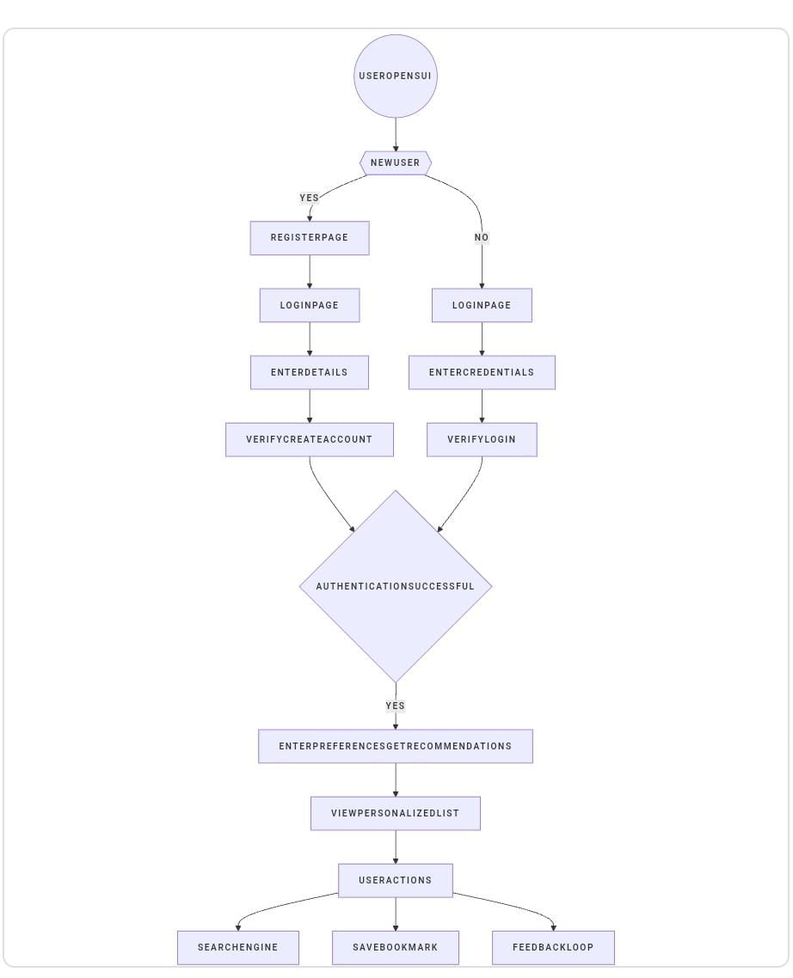
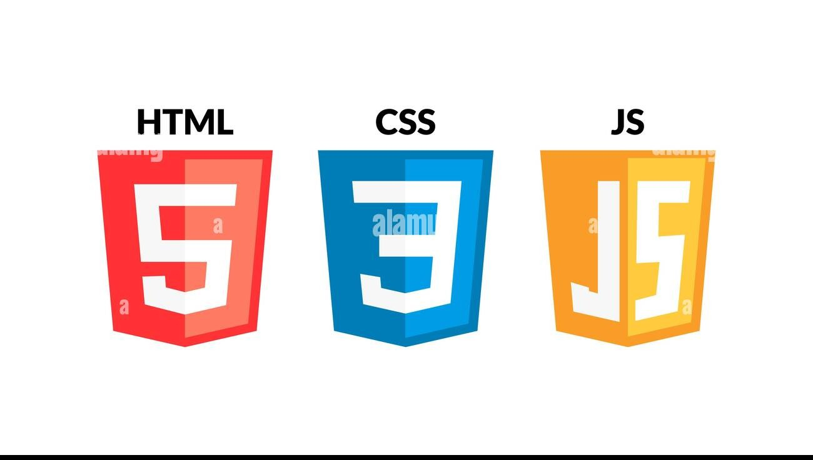
TECHNICAL APPROACH:
Technologies Used
UI :HTML, CSS, JavaScript, Node Js
Data Base:SQL

Slide 7
FEASIBILITY AND VIABILITY:
FEASIBILITY AND VIABILITY:
Easy for students, researchers, and professionals to use;
saves hours of research Can manage citations correctly and keep user data private.
Practical and realistic to implement, solves real-world research problems efficiently.
Strategies for overcoming these challenges:
1.Instead of hopping between PDFs, websites, and articles, gather all information in a single platform.
2. Summarize Smartly: Use AI to pull out only the important points, so you don’t waste hours reading everything.
3. Automatic Citation Tracking: Keeps track of sources and generates references, avoiding manual errors.
4. Show Most Relevant Results First: Prioritize reliable and useful information so users can focus on what matters.

Slide 8
IMPACT AND BENEFITS
Impact and Benefits
1. Time-Saving: Reduces hours of research into minutes by summarizing information from multiple sources.
2. Improved Efficiency: Consolidates PDFs, websites, and articles into one platform, minimizing fragmented research.
3. Better Accuracy: AI-powered summarization and automated citation tracking reduce errors in understanding and referencing.
4. User-Friendly Experience: Interactive web interface allows users to search, explore, and refine results easily.
5. Enhanced Productivity: Helps students, researchers, and professionals complete projects and assignments faster and more effectively.

Slide 9
RESEARCH AND REFERENCES
1. MDN Web Docs (HTML, CSS, JavaScript)
https://developer.mozilla.org
Comprehensive documentation and tutorials for web development.
2. W3Schools
https://www.w3schools.com
Tutorials and examples for HTML, CSS, JavaScript, and frontend design.
3. BeautifulSoup Documentation (Python Web Scraping)
https://www.crummy.com/software/BeautifulSoup/
Guides for scraping and parsing web data.
4. PyPDF2 Documentation (Python PDF Handling)
https://pypdf2.readthedocs.io/
Extract text and data from PDF files.
5. Flask Documentation (Python Backend Framework)
https://flask.palletsprojects.com/
Build backend APIs to connect frontend and Python processing.

